Slide 1
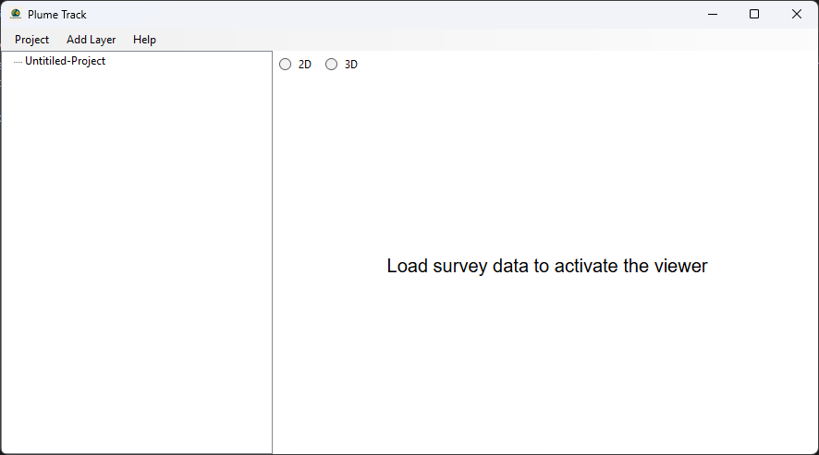
1
2
3

Slide 2


Slide 3
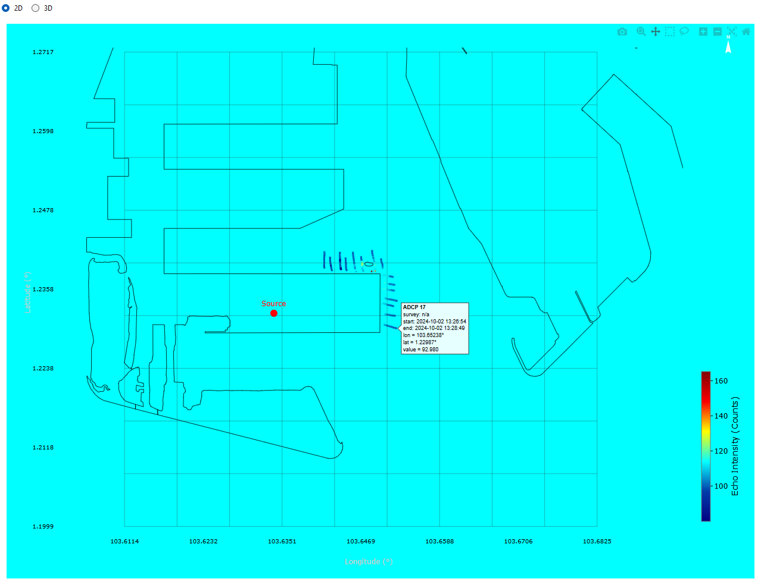
1
17
18
19
6
16
2
8
9
10
3
4
5
7
14
15
11
12
13

Slide 4
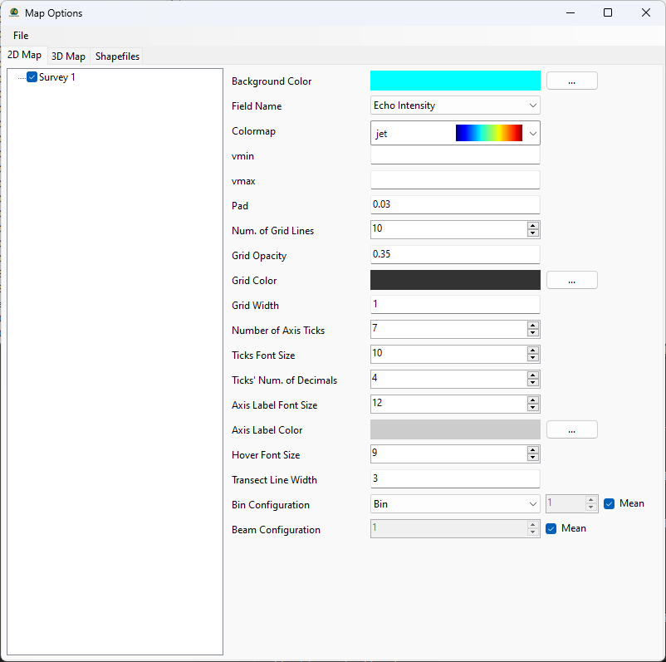
1
2
3
4
5
6
7
8
9
Surveys Panel
10
11
12
13
14
15
16
17
18
19

